Slide 1
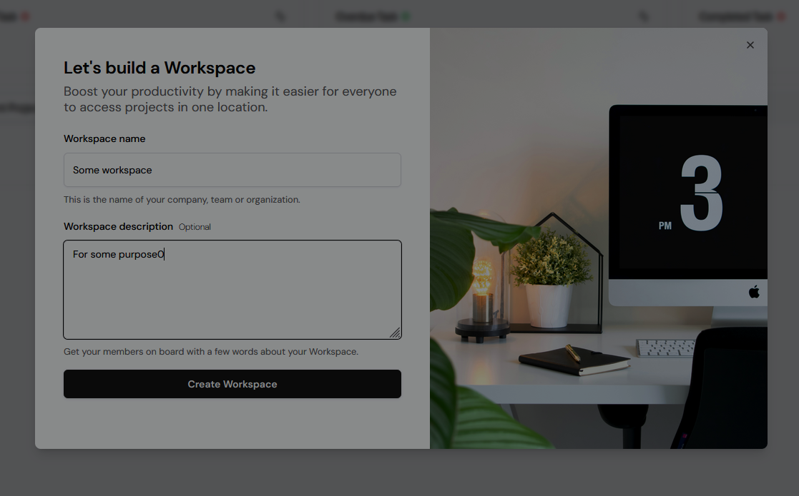
T-ming
A team-based project management system

Slide 2
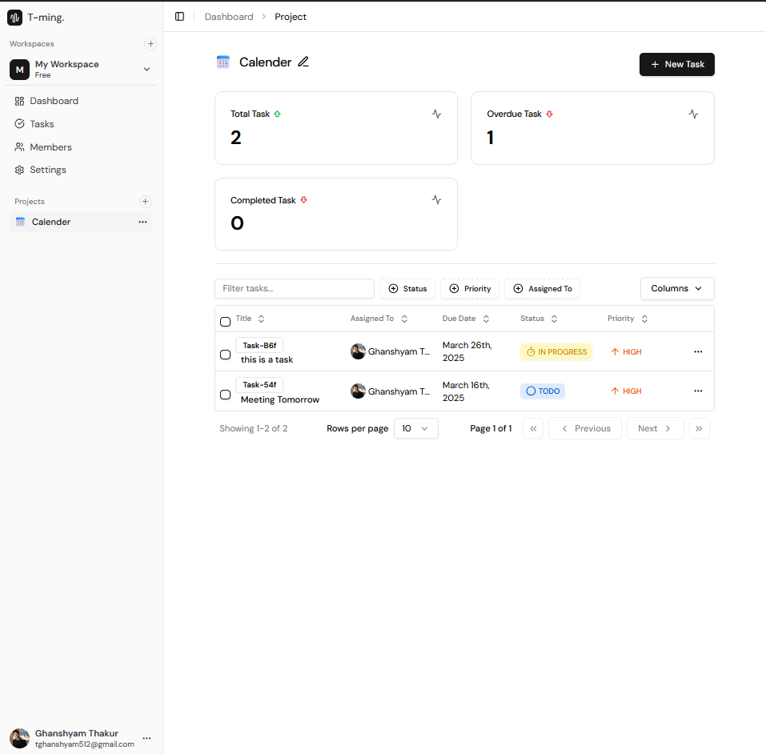
T-ming
Welcome to T-ming, a powerful and scalable team-based project management system built with Node.js, MongoDB, and React. Designed for real-world B2B needs, this project delivers features like Google Sign-In, workspace management, project tracking, task collaboration, role-based permissions, and more. Perfect for people looking for an application to manage their projects and teams.

Slide 3
KEY FEATURES
Authentication
Google Sign-In, Email, Password
Workspaces
Create & Manage Multiple Workspaces
Project & Task Management
Projects Management
Task CRUD (Create, Read, Update, Delete)
Status, Priority, Assignee
Security & Data Integrity
Cookie Session Management
Logout & Session Termination
Tech Stack
Built with MERN (MongoDB, Express, React, Node.js)
TypeScript for Strong Typing
Seeding for Test Data
User Roles & Access
Owner, Admin, Member
Invite Members to Workspaces
Smart Search & Filtering
Search by Status, Priority, Assignee
Advanced Features
Analytics Dashboard
Pagination & Load More

Slide 4
Modern Tech Stack for Development
Backend
Node.js – Scalable and efficient backend architecture
MongoDB & Mongoose – Flexible and scalable database solutions
Frontend
React.js – Dynamic and component-driven UI framework
Vite.js – Lightning-fast frontend development
Authentication & Security
Google OAuth – Seamless Google Sign-In integration
TypeScript – Type-safe and robust codebase
UI & Styling
Tailwind CSS & Shadcn UI – Beautiful, responsive, and modern design

Slide 5
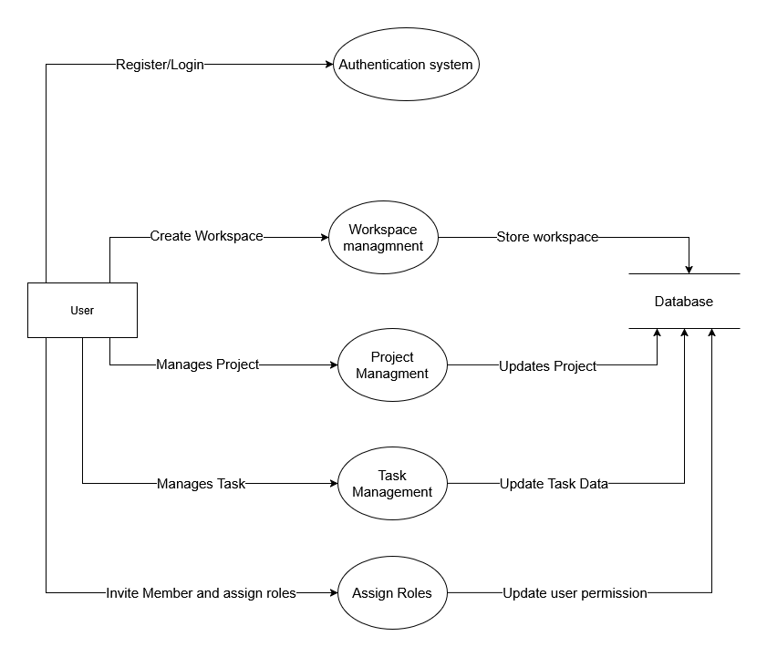
Data Flow Diagrams
Level 0 DFD
User Authentication: Users register or log in through the authentication system.
Workspace Management: Users create workspaces, which are stored in the database.
Project Management: Users manage projects, and updates are saved in the database.
Task Management: Users handle tasks, modifying task data in the database.
Role Assignment: Users invite members and assign roles, updating user permissions, and assigning and creating different tasks
Database Interaction: All processes interact with the database.

Slide 6
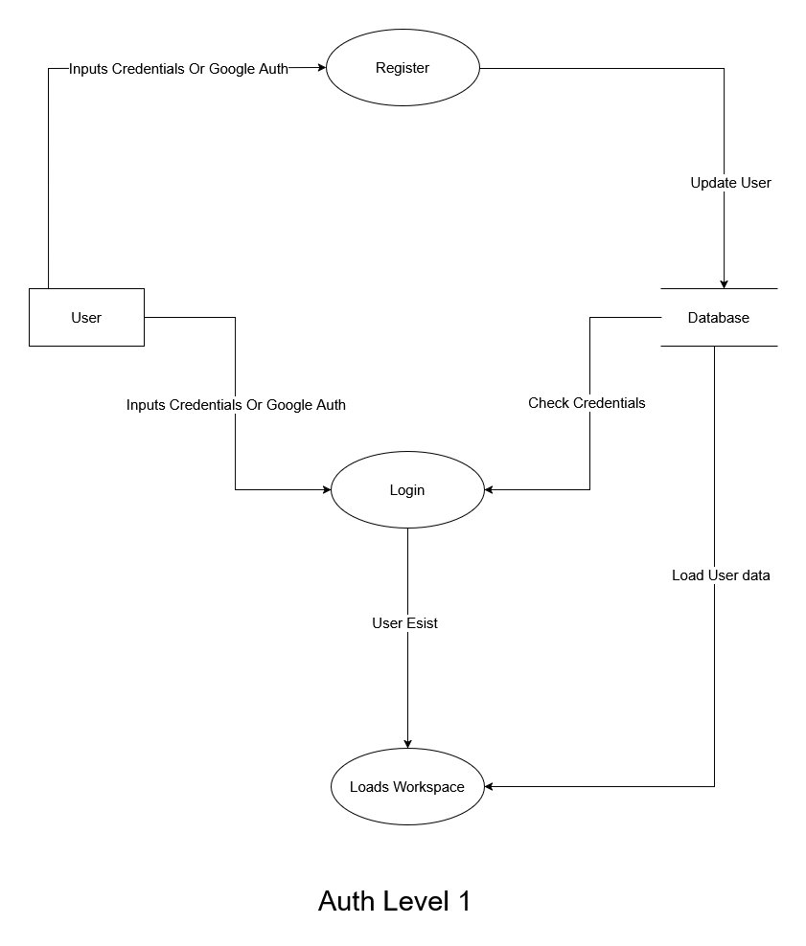
Data Flow Diagrams
Level 1 DFD Authentication
User Authentication: Users register or log in using credentials or Google Authentication.
Register Process: User credentials are stored in the database upon registration.
Login Process: Users input credentials, which are checked against the database.
Database Validation: The system verifies if the user exists and loads user data.
Workspace Loading: If authentication is successful, the user’s workspace is loaded.
Database Interaction: The database handles user registration, authentication, and data retrieval.

Slide 7
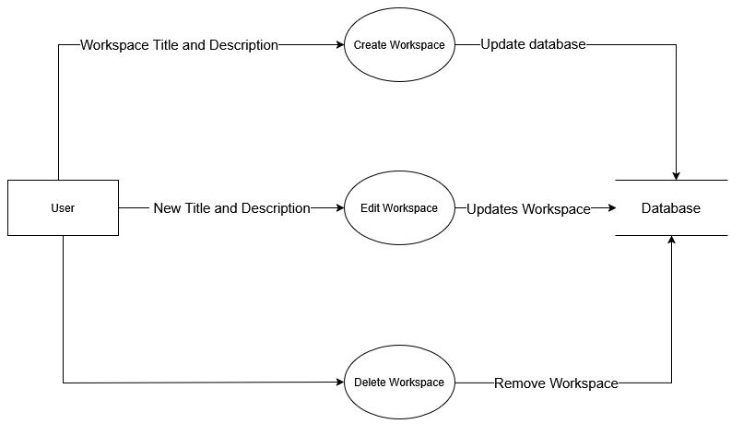
Data Flow Diagrams
Level 1 DFD Workspace Management
Workspace Creation: Users create a workspace by providing a title and description and the system stores the new workspace details in the database.
Workspace Editing: Users modify the workspace title and description and the system updates the workspace details in the database.
Workspace Deletion: Users delete an existing workspace. And the system removes the workspace from the database.

Slide 8
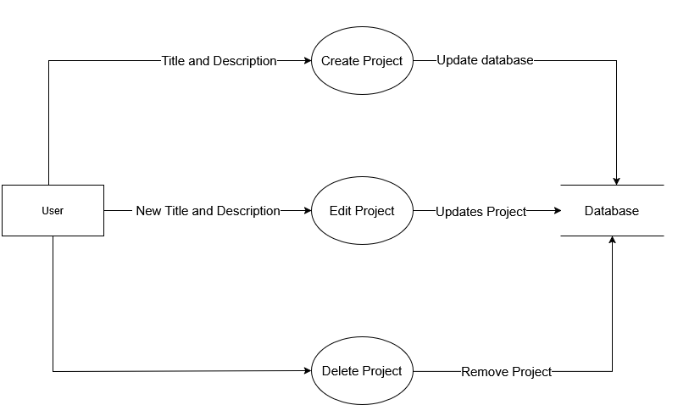
Data Flow Diagrams
Level 1 DFD Project Management
Project Creation: Users create a project by providing a title and description and the system stores the new project details in the database.
Project Editing: Users modify the project title and description and the system updates the project details in the database.
Project Deletion: Users delete an existing project and the system removes the project from the database.

Slide 9
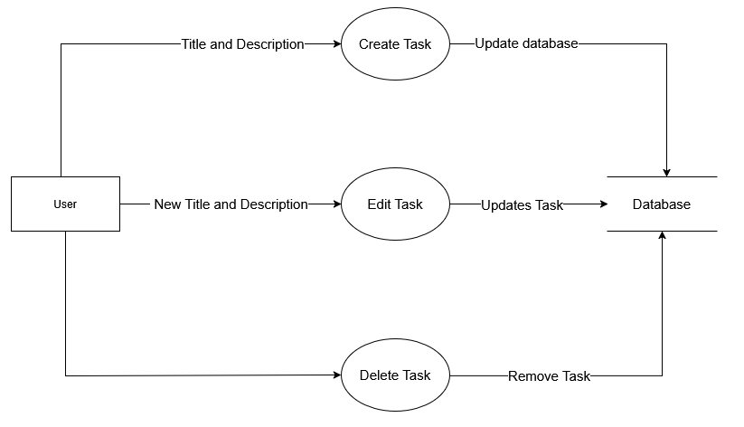
Data Flow Diagrams
Level 1 DFD Task Management
Task Creation: Users create a task by providing a title and description, and the system stores the new task details in the database.
Task Editing: Users modify the task title and description, and the system updates the task details in the database.
Task Deletion: Users delete an existing task, and the system removes the task from the database.

Slide 10
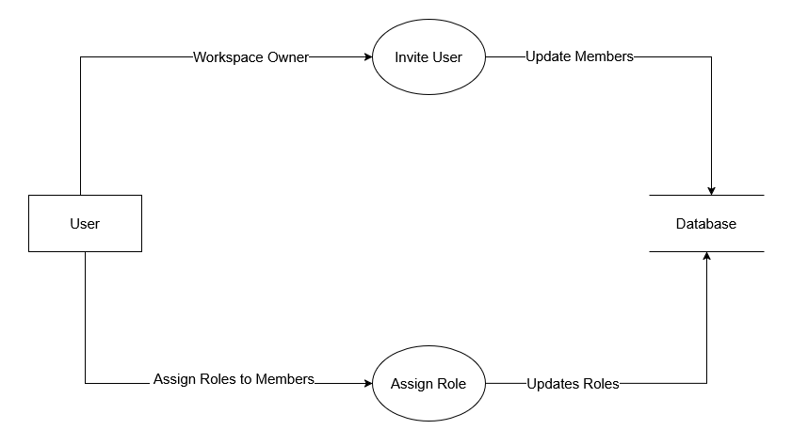
Data Flow Diagrams
Level 1 DFD User Management
User Invitation: The workspace owner invites a user, and the system updates the members in the database.
Role Assignment: The workspace owner assigns roles to members, and the system updates role details in the database.

Slide 11
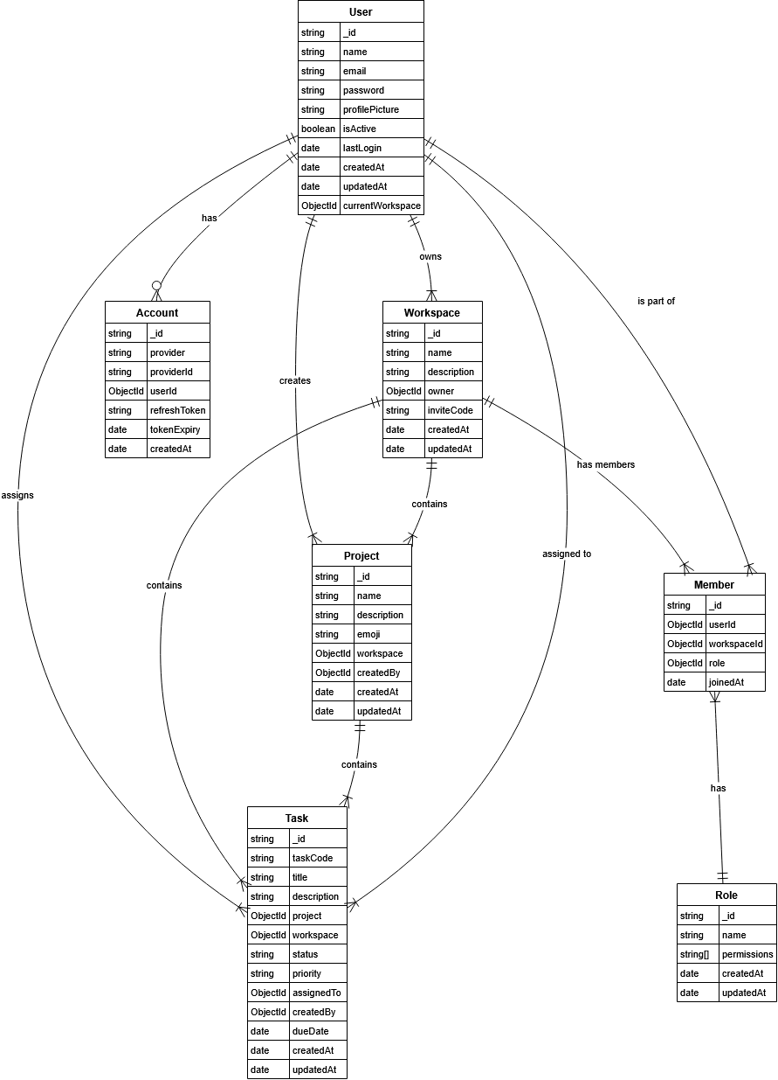
Entity Relationship Diagrams
Relationships:
A User creates a Workspace.
A User joins a Workspace as a Workspace Member.
A Workspace has multiple Projects.
A Project contains multiple Tasks.
A User is assigned a Role in a Workspace.
A Task is assigned to a User.
A Workspace has multiple Members with different Roles.
A User can have multiple authentication Accounts (Google Email, etc.).

Slide 12
Flow Chart
User Authentication Flow
The User can either Register (via Email/Google) or Log in.
Register User stores data in the User Database.
Login User checks credentials against the User Database.
If credentials are invalid, the user gets a Login Error.
If credentials are valid, the system checks whether the user has an existing workspace.

Slide 13
Flow Chart
Workspace Handling
If no workspace exists, a default workspace named "My Workspace" is automatically created and assigned to the user.
The user is assigned the OWNER role.
If a workspace already exists, the user is redirected to the first available workspace.

Slide 14
Flow Chart
User Dashboard & Workspace Management
On the User Dashboard, users can Create a New Workspace (stored in Workspace Collection), but only the Owner can perform this action.
Only Owners and Admins can Invite Members to the workspace, adding them to Workspace Members.
Only Owners and Admins can change the roles of existing members.
Only Owners and Admins can remove members from the workspace.

Slide 15
Flow Chart
Project Management Flow
Owners and Admins can Create a New Project (stored in Project Collection).
The Project can be edited by the Owner and admin
Owner and Admin have the permission to delete the project

Slide 16
Flow Chart
Task Management
Owners, Admins, and Members can Create a New Task and Assign it to any user.
Tasks are stored in the Task Collection and updated when assigned.
If a user wants to Edit or Delete a Task, the system checks their permissions:
Every role i.e. Owners, Admins, and Members can edit a task and update the Task Collection.
Only Owners and Admins can delete a task.

Slide 17
Flow Chart
In summary :
Default Workspace ("My Workspace") is created automatically if the user has no workspace.
Only Owners and Admins can manage workspace members and roles.
Members Role cannot create, edit, or delete Projects and workspaces. They can only create and edit Tasks
Owners, Admins, and Members can create and edit tasks, but only Owners and Admins can delete them.
.

Slide 18
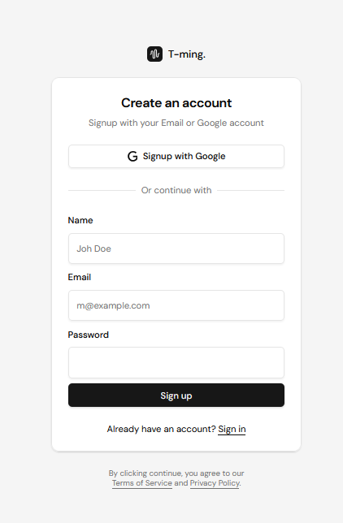
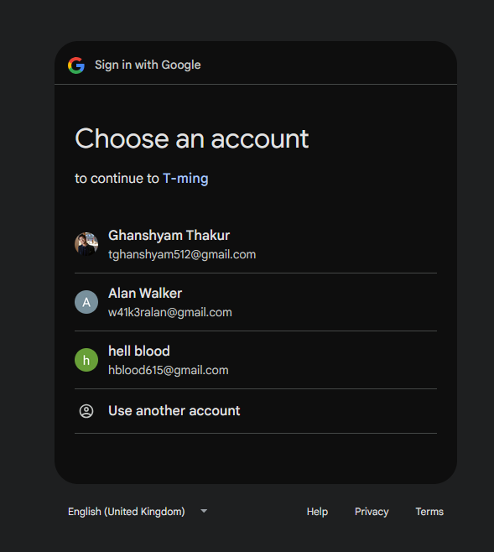
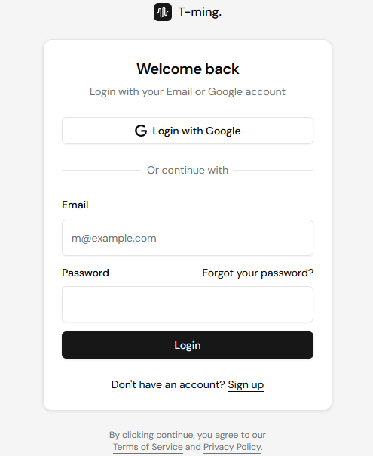
T-ming UI

Slide 19
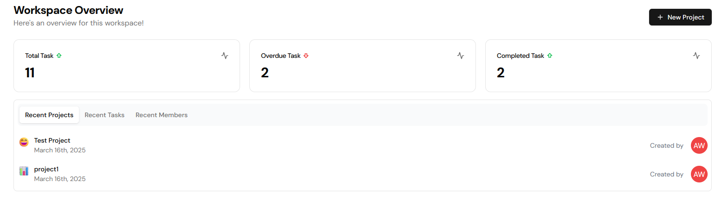
T-ming UI

Slide 20
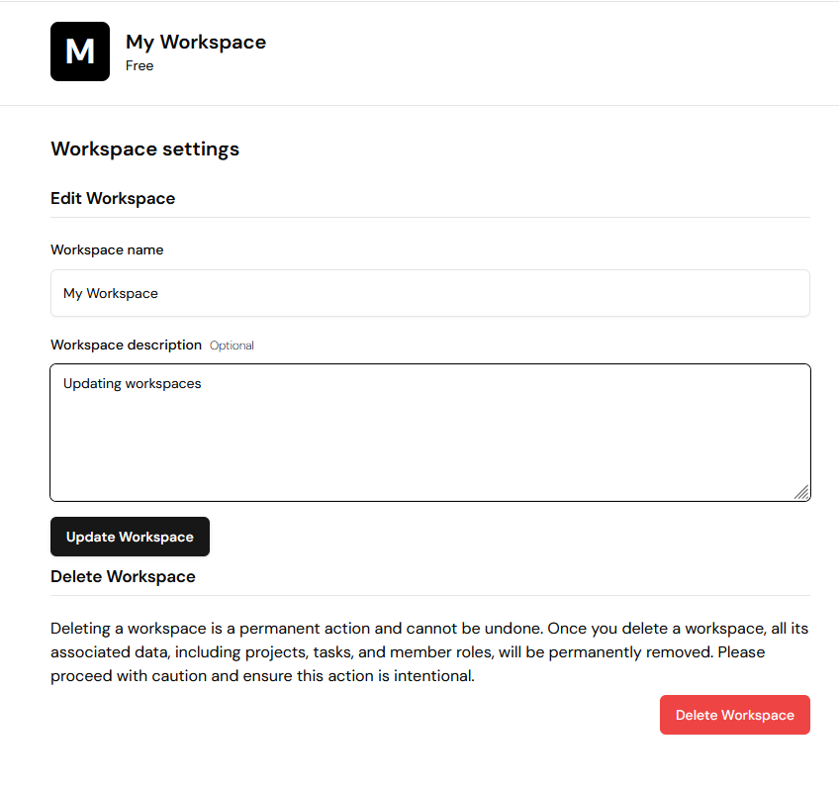
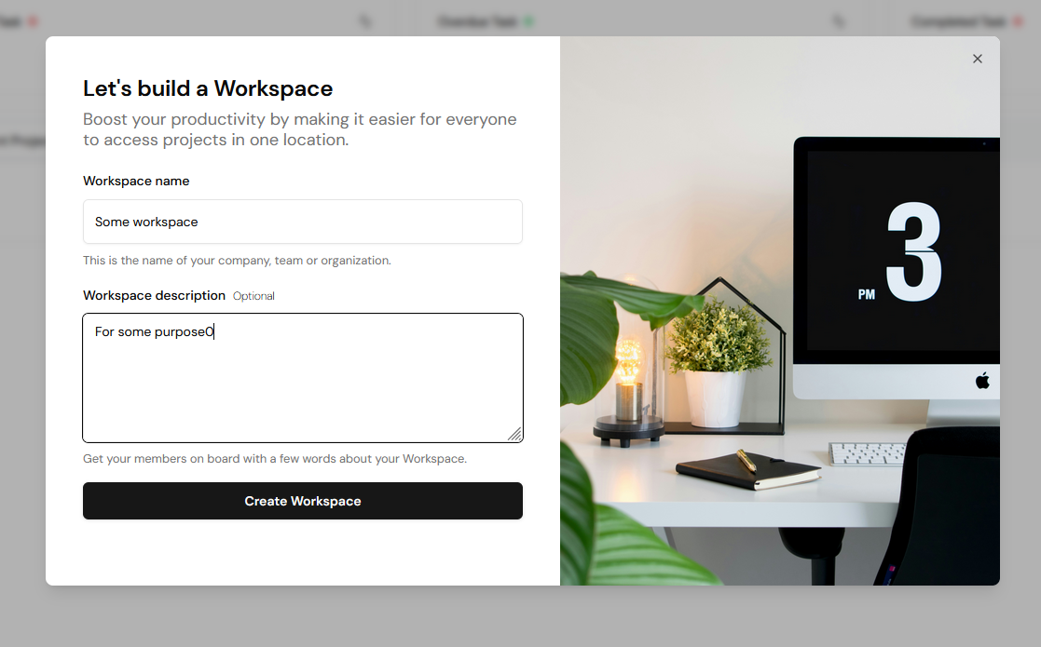
T-ming UI

Slide 21
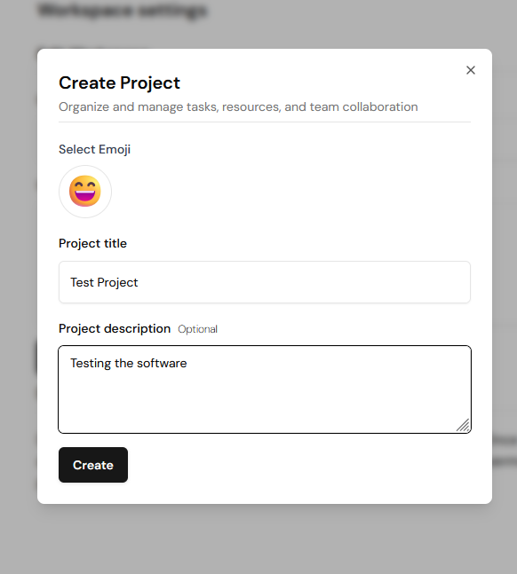
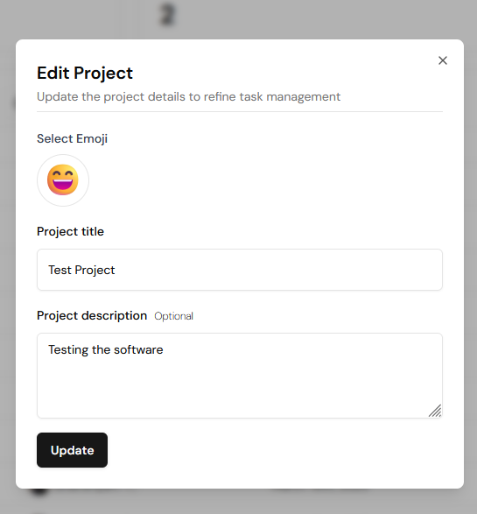
T-ming UI

Slide 22
T-ming UI

Slide 23
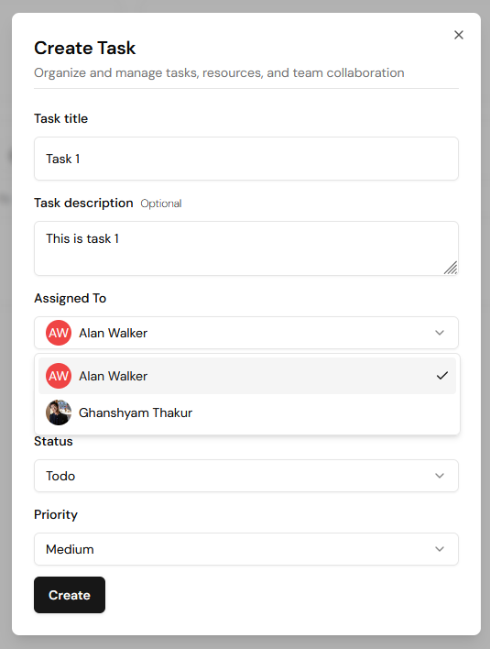
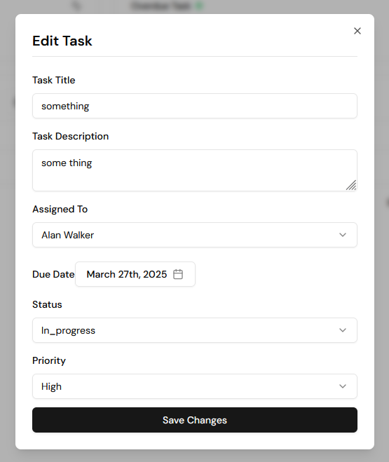
T-ming UI

Slide 24
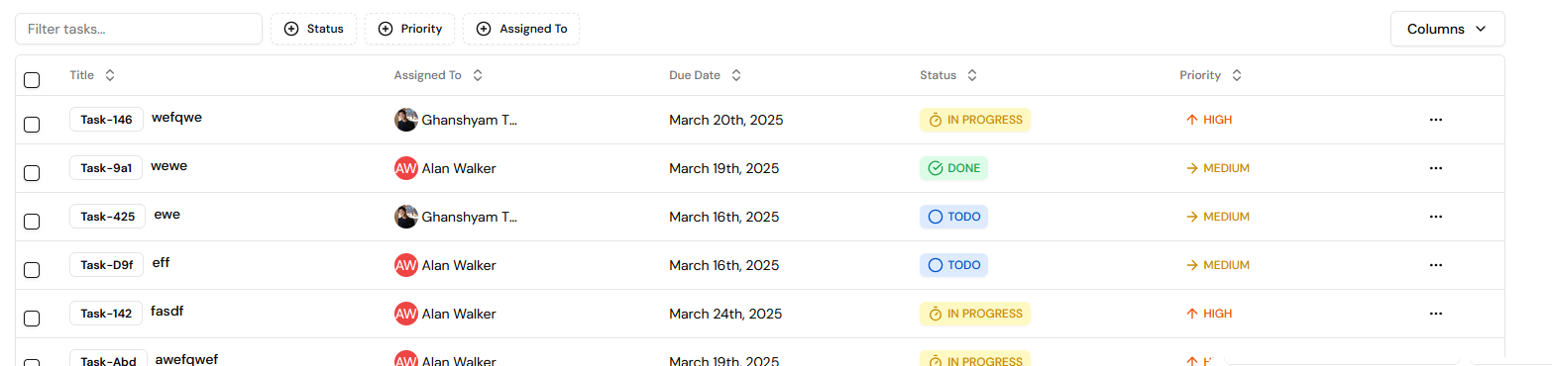
T-ming UI

Slide 25
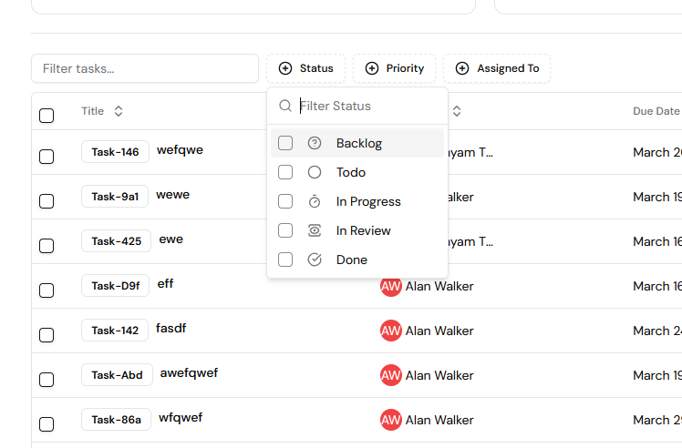
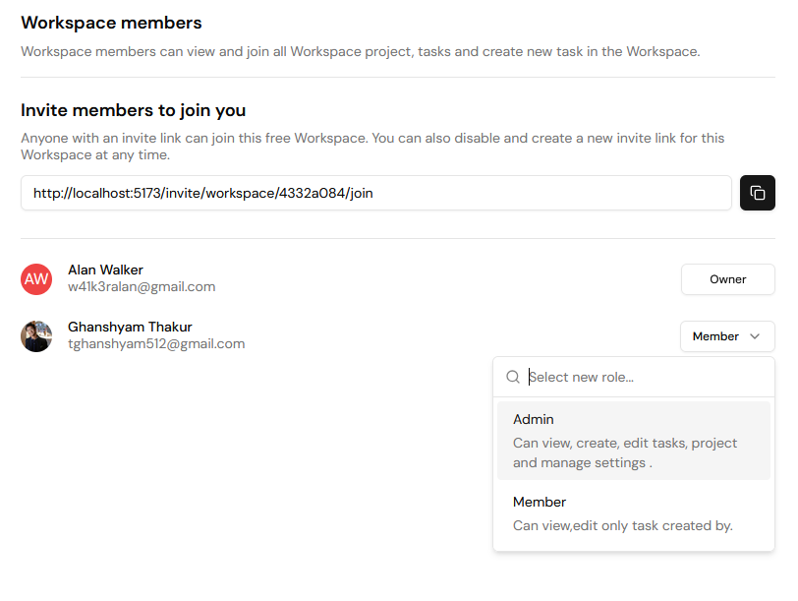
T-ming UI

Slide 26
T-ming
This application aims to provide a simple, efficient, and scalable solution for managing team-based or solo projects, or tasks, while ensuring secure authentication and access control. Using modern technology, it provides a simple and clear way for teams to work together without confusion. With automated workspace setup and clear permissions, teams can focus on their work more efficiently, making project management more organized and user-friendly.

Slide 27
This is T-ming
A team-based project management system
Thankyou
Crafted with Code and Computers by:
Divya Jyoti and Ghanshyam
Special thanks to my laptop and google

